Slide 1

Topic: Memo and Applications Writing Sir, Muhammad Zaman Hashmi

Slide 2
What is Memo?
A memo (also known as a memorandum, or "reminder") is used for internal communications regarding procedures or official business within an organization
Unlike an email, a memo is a message you send to a large group of employees, like your entire department or everyone at the company.
You might need to write a memo to inform staff of upcoming events or broadcast internal changes.

Slide 3
When you should write a memo
broadcast internal changes
disseminate news
share an upcoming event
update public safety guidelines
raise awareness about an issue
address a problem
make a request
share project updates
What is the purpose of a memo?
Memos are designed for official internal communications of a business or organization.
They are often sent to an entire organization but are also useful for informing a single department, team, or smaller group of people.
Memos disperse necessary information using a simple, easy-to-follow format.

Slide 4
Structure of a Memo
Part 1: HEADER
TO: provide the names and titles of everyone who will receive your memo
FROM: provide your complete name and title
DATE: provide the complete and accurate date – don’t forget to include the year
SUBJECT: provide a brief, yet specific description of what the memo is about
Part 2: MESSAGE
Introduction – explain the purpose
Body – addresses the information required
Conclusion – (Summary and possible recommendations)
Note:
Each paragraph contains one main idea or point.
A paragraph can be one sentence long.
Arrange points in a logical sequence.

Slide 5
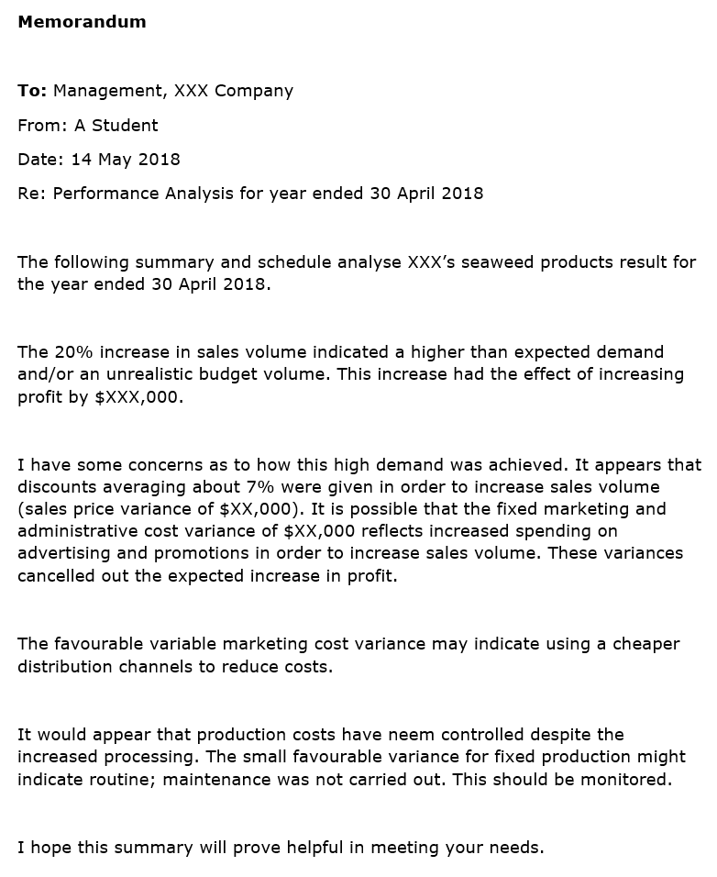

Slide 6
Tips to Be Effective at Memo Writing
Be SMART. Memos should be SMART – Specific, Measurable, Attainable, Relevant, and Time-Bound. Be clear not only about what you want to say, but what you expect your reader to do.
Don’t use informal language. Memos, by their nature, need to be written in a professional manner. As such, do avoid colloquial language.
Be succinct. As mentioned earlier, memos should go straight to the point. Avoid flowery language and adding unnecessary details so that your readers will know exactly what you’re trying to say.
Present the main point within the opening paragraph. Make it easier for your reader to understand what the memo is about by stating the gist of it within the first paragraph. Salutations are not necessary in memos.
Break down the memo. If your memo is long, consider breaking it down into smaller chunks to make it easier for your readers to understand what you want to say.
Don’t use emotionally-charged words or language. Never use emotive words, even when writing about issues such as a team member’s poor performance at work
Proofread. Before you release the memo, make sure that you proofread it to see if there are any factual, grammatical, or spelling errors in what you wrote.

Slide 7
Application Writing

Slide 8
Topic: Application format
Tips to How To Write an Application
• Salutation
• The subject of the application
• Reason for Your leave
• Number of leaves needed (particular dates
• Complimentary
• Name signature
• Date
To, (To comma)
Sender’s name or title
Address: complete address: school name comma/ town comma and city full stop
Subject: Subject must capitalized each word. Not more than 3 to 4 words (1 line short)
Salutation Sir, respectable madam, comma.
Most respectfully 1beg to say that (purpose of application is mentioned here) for example I have urgent piece of work/ brother marriage/ I am sick etc. . . . Kindly, grant me two days leaves of absence from school. (Main body)
I shall be very thankful to you this act of kindness. ( complimentary sentence)
Yours Obediently,
Name ………………….
Signature ……………
Roll No……………….
Day + Month + comma+ year + full stop
Date …25th July, 2022. (Not 25/ 07/ 2020)
Note: only purpose of application “problem” sentence change and rest of contents of application remain same for all leaves applications
Don’t use apostrophe with yours do Obediently “O “capital and use comma after obediently.

Slide 9
Leave Application To Boss For Going Out Of Station
Sample 1
From, Your Name Your Address Date
To, The boss Office address
Respected sir, I’m your name, working as a marketing agent (Mention your job title) in your company. For some urgent work, I have to out of the station
I have some work in my native place and I need to go there. I request you to please give me 3 days leave (that is from _ to_). It’s very urgent. I request you to kindly give me 3 days leave.
Thanking you Yours faithfully Your Name
Date 24th October, 2020

Slide 10
Thank You for Patiently Listening!

